Slide 1
Serene Serenity Application Framework

Slide 2

What is Serenity Platform
Download: Serenity.Template.vsix from Microsoft Visual Studio Gallery to Install to Visual Studio 2012/13/15.
About Serenity Platform:
Serenity is an ASP.NET MVC application platform designed to simplify and shorten development of data-centric business applications with a service based architecture.
It aims to make development easier while reducing maintenance costs by avoiding boiler-plate code, reducing the time spent on repetitive tasks and applying best software design practices.
Get Serenity
CLICK TO DOWNLOAD

Slide 3
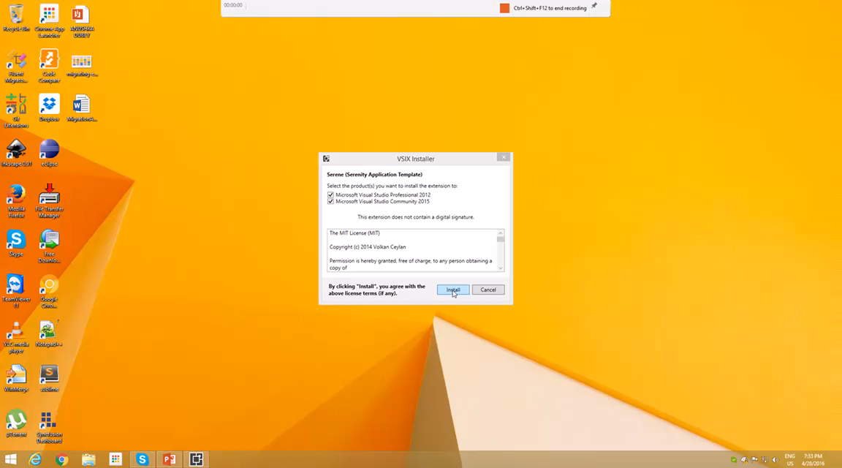

Slide 4

What’s Next
Core component in Serenity, Adding CRUD functionality for new table
Fluent Migrations
Adding new table
Generating Code using SerGen.Exe
Running updated solution
CLICK TO SEE THIS
MIX IN YOUR BROWSER

Slide 5
Thank you
References:
Download: https://visualstudiogallery.msdn.microsoft.com/559ec6fc-feef-4077-b6d5-5a99408a6681
Source Code:
Framework: https://github.com/volkanceylan/Serenity
Template: https://github.com/volkanceylan/Serene
Tutorials
https://github.com/volkanceylan/Serenity-Tutorials
Developer Guide
https://www.gitbook.com/book/volkanceylan/serenity-guide/details

